Slide 1



TRAVEL PLANNER
Name: Dhruvi Patel
Enrol no.:23002171210028
Batch:B-1
Rollno.:17
Branch: CSE
LJ INSTITUTE OF ENGINEERING AND TECHNOLOGY
LJ UNIVERSITY

Slide 2


PROJECT OUTLINE:-
PURPOSE OF THE PROJECT:
The Travel Planner Application is a comprehensive software tool designed to assist travelers in planning and organizing their trips effectively. It provides users with features to research destinations, select itineraries, book accommodations, manage budgets, and share travel plans with others. The application leverages data structures for efficient data management, database management systems for persistent storage of travel-related information, and Java programming for building the frontend and backend components.

Slide 3
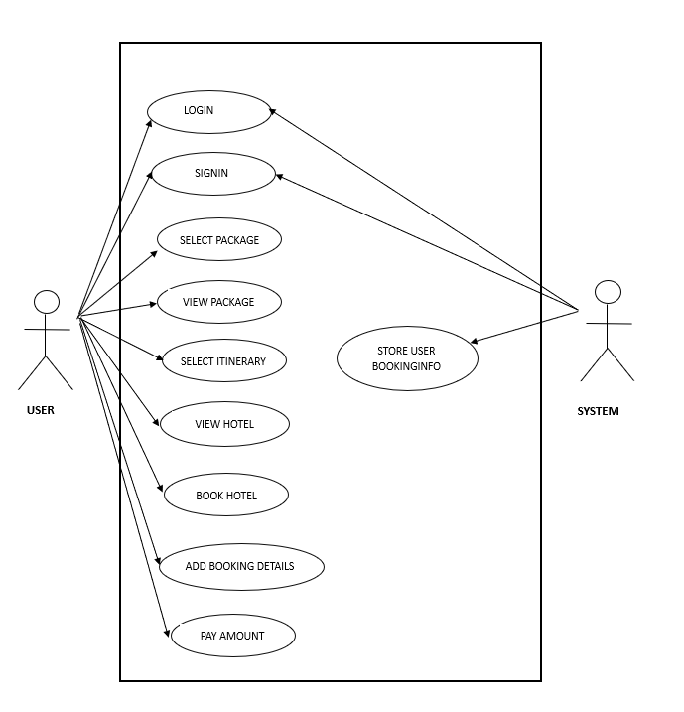
USE
CASE
DIAGRAM:

Slide 4
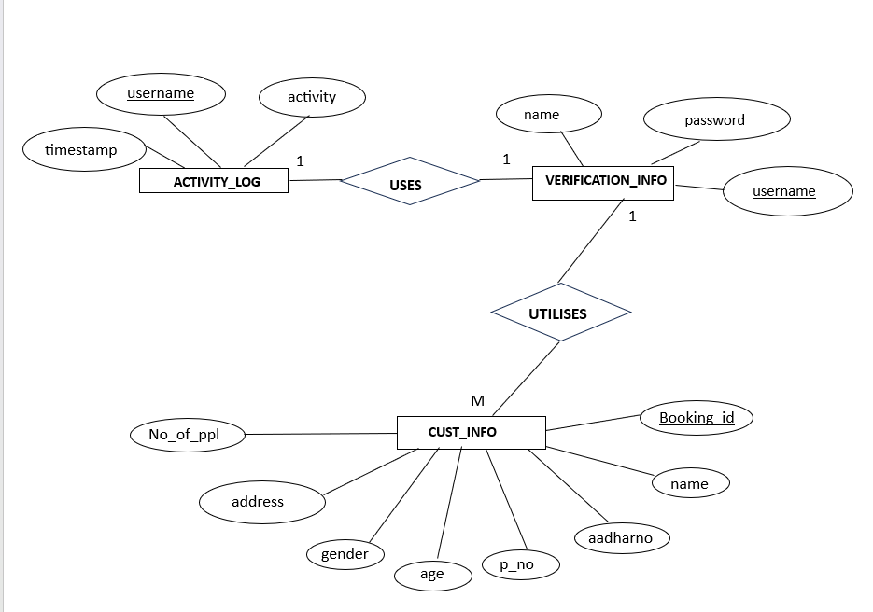
ER
DIAGRAM:

Slide 5
FUNCTIONALITIES:
The user is able to do the following things to book his Travel Plan:-
Create a new account
View and book from available travel packages.
Choose itinerary.
Choose hotel and view its photos.
Book the selected hotel by adding details and number of persons.
Pay via different available payment options.

Slide 6
DS USING JAVA | JAVA | DBMS
LinkList-managing collection of travel packages, photos | Inheritance (Extends, implements) | Insertion of user info for signup
ArrayList-store hotel pics | multithreading in splash | Insertion of user data for booking
HashMap-to store user sign in info | Exception handling for age validation | Trigger for making verification_log
Array-to set gender from dropdown | Packages | Procedures for taking all user inputs
Stack for undo redo in JFrames | For each loop
 | Runtime polymorphism toString(), actionPerformed()
 | JDBC to store user data in database(Prepared and Callable statements).
 | File io for printing itinerary data and receipt generation.
 | Java Swing and AWT for GUI

Slide 7
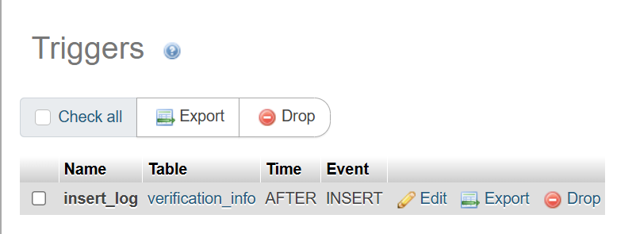
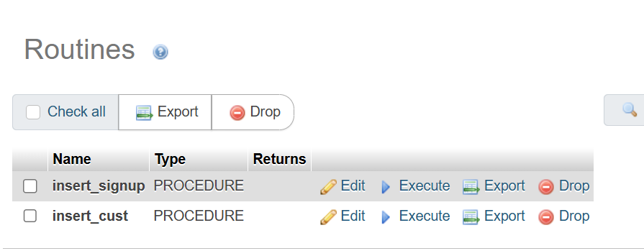
Triggers and Procedures:
It is a database mechanism that automatically executes a response to certain events on a table, such as INSERT, UPDATE, or DELETE.
Stored procedure is a set of SQL statements stored together as a single block of code in the database which can be reused multiple times

Slide 8
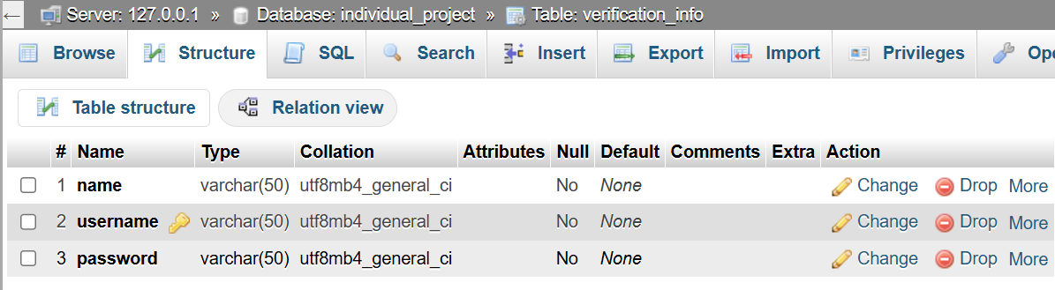
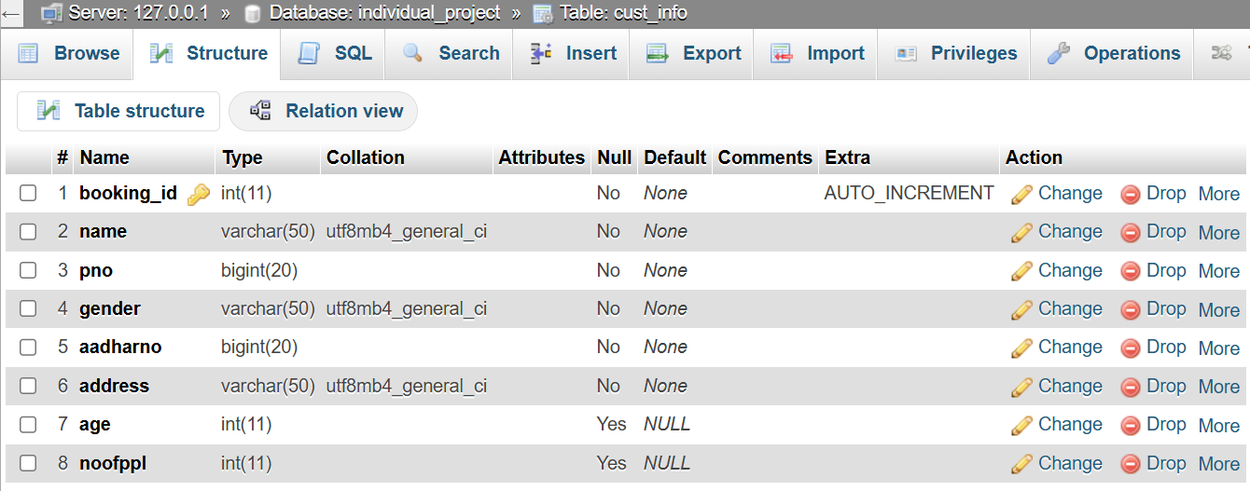
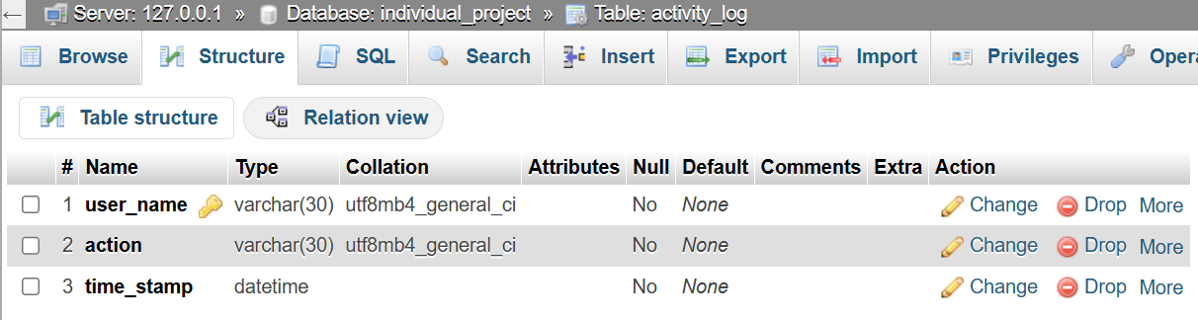
Schemas of database:

Slide 9
MERITS AND DEMERITS:-
MERITS:
Makes travel planning simple and less time consuming.
Gets to go back or quit at any step.
Gets to view photos wherever possible.
DEMERITS:
Has to book transportation on own.
Has no way to cancel booking.

Slide 10
FUTURE SCOPE:
Integrate it with payment gateway.
Integrate it with google maps.(For location and reviews)
Add transportation options like booking flights or trains with booking the packages.
Add transport facility for internal travelling like sedan car, tempo traveller, suv etc.

Slide 11
THANK YOU!!

